Slide 1

CLOUD SECURITY
Presented by:
Miryam Shawulu Nggada (M00680182)
John Odi Etta (M00783479)
Steve Oseghale-Philip (M00826567)

Slide 2
TOPICS
What is Cloud Computing?
Background
Security Infrastructure in the Cloud
Security Management in the Cloud
Cloud Security Mechanisms
Limitations & Risks Associated with Cloud Computing
Data Protection/Privacy in the Cloud
Bridging data protection and Cloud Security
Critical analysis
Conclusion

Slide 3

01.
WHAT IS CLOUD COMPUTING?
It is the delivery of computing administrations including servers, database, storage, software, networks, and intelligence over the Internet to offer quicker advancement and adaptable resources.

Slide 4
BACKGROUND
The expression ‘cloud computing’ itself was authored in 1996
Clouds can be seen some place in the sky
The cloud service providers offer different types of assistance dependent on some abilities e.g.
PaaS
SaaS
HaaS
IaaS
XaaS
It stems from the need to be able to make data and computer resources available
In recent years the number of cyberattacks and security breaches has increased

Slide 5
HISTORY
FLOPPY DISKS
CD/DVD
CLOUD
01
02
03

Slide 6
SECURITY INFRASTRUCTURE IN THE CLOUD
Types of cloud
Public - refers to computing services offered by third-party cloud service providers (CSPs)
Private - cloud are dedicated cloud resources accessible to a single entity
Hybrid - the combination of both private and public cloud environments
Service models
SaaS - consumers use pre-provided applications and do not manage or control the network, storage facilities, and applications
PaaS - service lets organizations write software for integrating existing applications or develop custom applications
IaaS - the cloud user is responsible for administrating and maintaining the operating systems and applications

Slide 7
SECURITY INFRASTRUCTURE IN THE CLOUD
Frameworks
ISO
security-focused framework that is independent of financial and legal regulations
constitutes a wide range of guidelines organizations can use
NIST
allows companies to develop their information security, risk management, and control programs
based on existing standards and guidelines
COSO
is centered on enterprise risk management, internal control, and fraudulent activity deterrence
also integrates risk considerations into the design

Slide 8
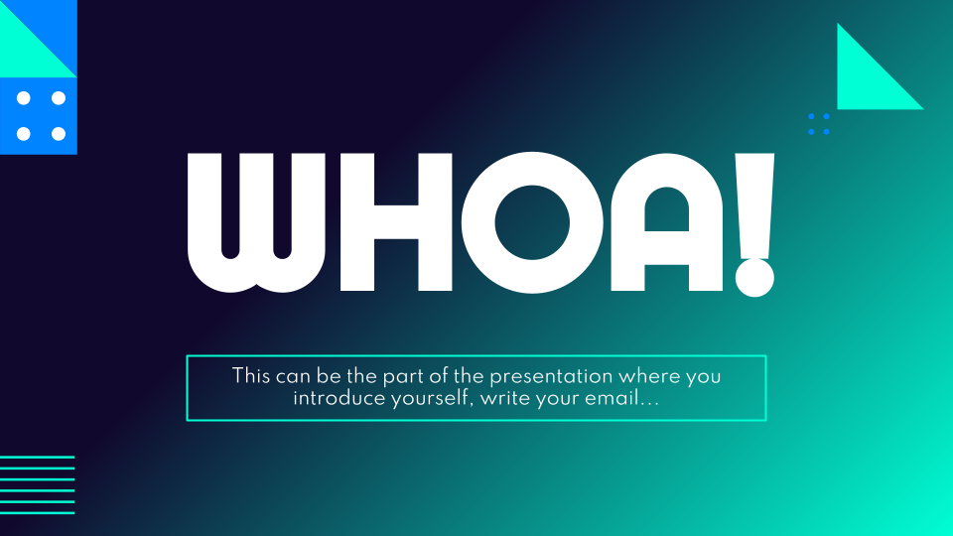
SECURITY MANAGEMENT IN THE CLOUD
Few ISO 27001-Annex A controls
A.5 Information security policies, controls on how the policies are written and reviewed
A.7 Human resources security controls prior to employment, during, and after employment.
A.10 Cryptography controls related to encryption and key management
How can cloud security infrastructure be managed effectively to ensure adequate and continuous protection in the cloud?

Slide 9
CLOUD SECURITY MECHANISMS
ENCRYPTION
ACCESS CONTROL
AUTHENTICATION
critical safeguard for information and system resources
3 main models:
Discretionary Access Control (DAC): only the owner of the data can grant access
Mandatory Access Control (MAC): The administrator decides which users can access files
Role-Based Access Control (RBAC): access is granted solely on the user's role
This process ensures that the information cannot be intercepted
When plaintext data is encrypted, it is linked with a string of characters
The encryption key is used to restore the plaintext
Two types of methods (Asymmetric & Symmetric)
Single-factor authentication – username and password
Knowledge-based authentication - where hidden user identification information is required before access
Multi-factor authentication - a user to be identified in two or more different methods
Adaptive authentication - uses environmental characteristics and behavioural profiling

Slide 10
LIMITATIONS & RISKS
Privacy & security
known security challenges that represent significant hazards e.g. phishing, DOS (denial-of-service)
Hackers can utilize cloud to construct a botnet
Service agreement
there is no standard SLA for directing a provider's services
each cloud vendor has its own stated SLA
lack of a good SLA is a stumbling block to data movement between suppliers
Service availability
customer discontent might be sparked by even a minor piece of missing data
service like VOIP requires ongoing availability

Slide 11
LIMITATIONS & RISKS
Vulnerabilities outlined by Gartner
Regulatory compliance: ensures that cloud service providers are in line with security standards set by law
Data location: addresses if the business management can decide where the data is stored
Data segregation: addresses whether encryption methods are implemented at every level of information
Recovery: deals with the event of data loss due to disaster of other occurrences
Data availability and Interoperability: Can the cloud vendor move all of an organization’s information to another domain? Or can the customer move from one vendor to another while retaining the data’s integrity?

Slide 12
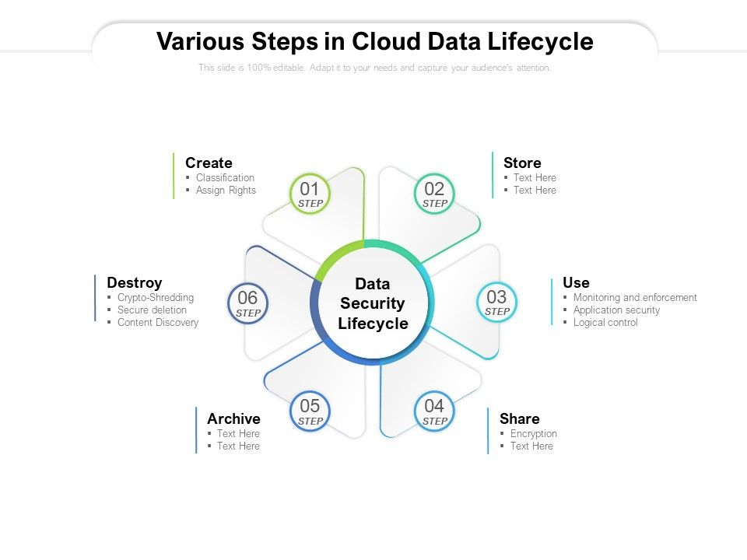
DATA PROTECTION/PRIVACY IN THE CLOUD
Data Life Cycle
cycle envelops every one of the stages that information goes through
reason for such a methodology is to permit an organization to recognize the stages information goes through
The Cloud Security Alliance (CSA) has fostered the cloud information lifecycle, perceiving six phases

Slide 13
DATA PROTECTION/PRIVACY IN THE CLOUD
Data Management
Huge volumes of information in distributed computing conditions present enormous infrastructure challenges
Transparency of data towards the clients and information subjects should be unique
Data should not be compromised - to make a different backup account with a ‘write only’ policy
Access control management - specific degree of control on the information when it leaves the application is important

Slide 14
DATA PROTECTION/PRIVACY IN THE CLOUD
Principles & Law Regulations
COLLECTION LIMITATION - says that assortment of individual information needs to be restricted to the base measure of information
ACCOUNTABILITY PRINCIPLE - rule expresses that an organization is in charge of for individual data under its influence
FISMA - requires that security controls be given proportionate to the danger impact level to the data framework
SECURITY AS A SERVICE - is when organizations give security just as a cloud service, and do not give typical customer/server security items for hosts etc.
IDENTITY MANAGEMENT AS A SERVICE - endeavours to give services to IAM (identity and access management ) in the cloud

Slide 15
BRIDGING DATA PROTECTION & CLOUD SECURITY - Methods
CIA Traid
Authorization & Access Control
Encryption
stands for confidentiality, integrity and availability
An algorithm has been proposed to identify the genuine effect of losing properties of the data
Single-factor verification is a great start but, it is encouraged to carry out multi-factor authentication
SSO allows users to login to various applications through one confirmation source
Access control - Firewalls, Intrusion detection systems
Digital signature with RSA algorithm plot is proposed
SSL 128 cycle encryption is utilized which can be then expanded to 256-digit encryption

Slide 16
BRIDGING DATA PROTECTION & CLOUD SECURITY - frameworks
MTCS
model expands upon the global principles ISO/IEC 27001:2005
plan is organized by usage types, sensitivity of information and sorts of uses being facilitated
ISO27018
part of the series of ISO27000 principles
determines rules dependent on ISO/IEC 27002, thinking about the administrative requirements
CSA OCF (Cloud Certification Alliance’s Open Certification Framework)
OCF is a program for adaptable, steady and diverse cloud supplier affirmation
program will coordinate with well-known outsider evaluations

Slide 17

CRITICAL ANALYSIS

Slide 18
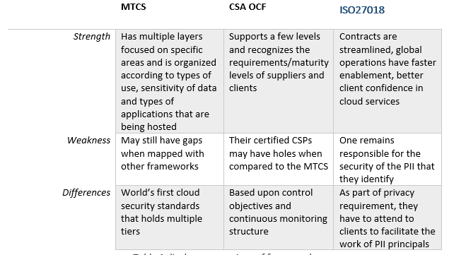

Slide 19
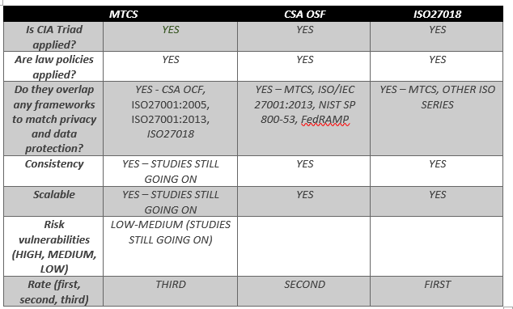

Slide 20
MTCS still needs more research
It only matches 41% of ISO27018 requirements
Only those that can match with the ISO27018 were matched
Gaps will need to be rectified by matching certain reports apart from the standards (with CSA OCF)
Matching MTCS to other frameworks it will minimize the work for the cloud service providers to gain the MTCS certification
Within these frameworks, there are better security techniques to be used

Slide 21
Conclusion
cloud computing is as yet another quick advancing scene and allows space for a lot of activities to make life easier
we should keep on developing our cycles, strategies, and procedures
One of the greatest security issues with the distributed computing model is the sharing of assets
It is seen that new and emerging frameworks have potential
THANK YOU!!!

